Slide 1
What is system and information system?
A system
is a group of interrelated components that function together to
achieve a desired result. There are three major components in every
system, namely input, processing and output.
Information system (IS)
is an arrangement of people, data, processes, and information
technology that interact to collect, process, store, and provide as
output the information needed to support an organization.

Slide 2
What is system analysis and system design?
Systems Analysis
understanding and specifying in detail what an information system
should do.
System Design
specifying in detail how the parts of an information system should be
Implemented.

Slide 3
What is system analyst and system designer?
Systems analyst – a specialist who studies the problems and needs of an organization to determine how people, data, processes, and information technology can best achieve
improvements for the business.
System designer – a technical specialist who translates system users’ business requirements and constraints into technical solution. She or he designs the computer databases, inputs, outputs, screens, networks, and software that will meet
the system users’ requirements.

Slide 4
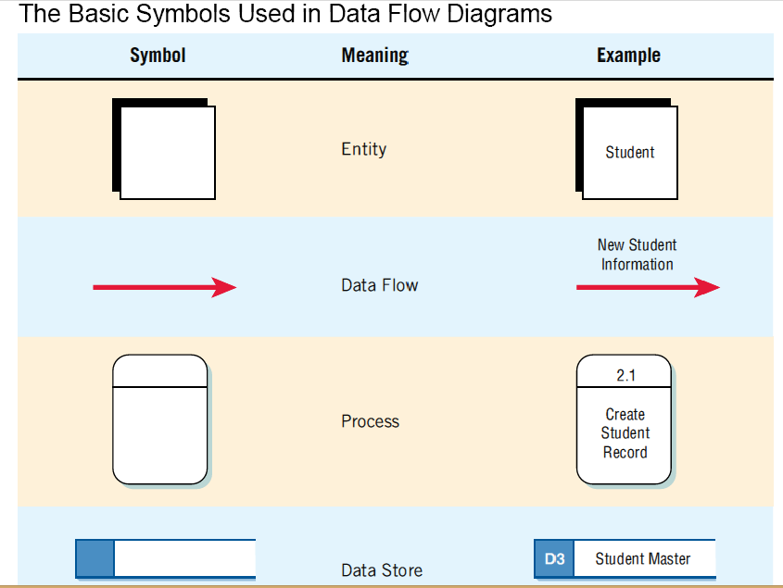

Slide 5
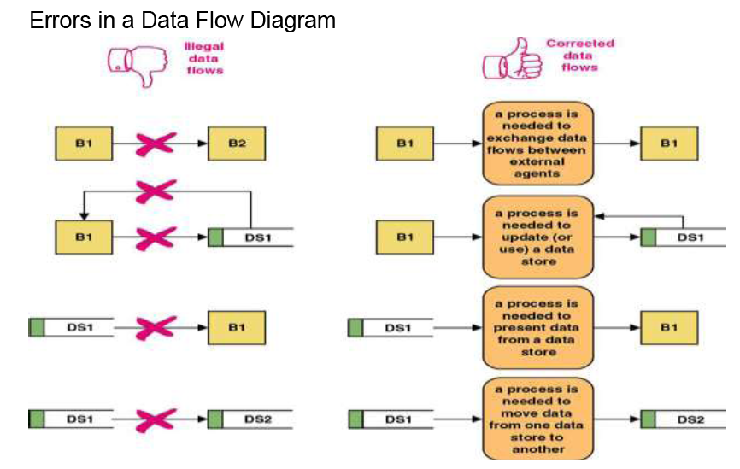

Slide 6
Context-Level Data Flow Diagrams
Focus is on the data flowing into and out of the system and the processing of the data.
Shows the scope of the system:
What is to be included in the system.
The external entities are outside the scope of the system.
Notes:
Sometimes called an environmental model.

Slide 7
Context Diagram?
System Context Diagrams are diagrams used in systems design to represent the more important external actors that interact with the system at hand.
This type of diagram usually pictures the system at the center, with no details of its interior structure, surrounded by all its interacting systems, environment and activities.
The objective of a system context diagram is to focus attention on external factors and events that should be considered in developing a complete set of system requirements and constraints.

Slide 8
Context Diagram Building Procedure
Identify external entities (providers, receivers of system info)
Identify the system and its boundaries (the context)
Identify external data flows (input, output)
However, NO DATA STORE !!!
Note: the whole system itself is a process (it receives input and transforms into output)

Slide 9
The Basic Symbols of a Data Flow Diagram (in context diagram)
Notes:
Process - transforms incoming data into outgoing information, the content level has only one process representing the entire system.
Entity - Entity, a person, group, department, or system that supplies or receives information.
Data flows – the lines that connect external entities to the process.

Slide 10
Vending Machine Example Assumption: there is no revise order option
Submit order
Vending Machine System
Customer
Send order

Slide 11
ATM Example Assumption: ONLY withdrawing money (not transfer, checking balance, or other services….)
Request transaction
ATM System
Customer
Complete transaction
Or
Revise transaction

Slide 12
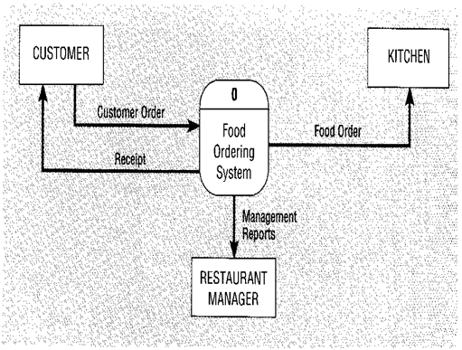
Food Order processing System

Slide 13
Context diagram example
A student sends in an application form containing their personal details, and their desired course
The university checks that the course is available.
If the course is available and the student is enrolled in the course, the university confirms the enrolment by sending a confirmation letter that they are registered for the course to the student.
Or if the course is unavailable the student is sent a rejection letter.
What system is being modeled?

Slide 14
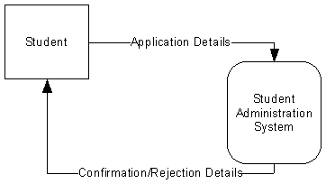
Context diagram example

Slide 15
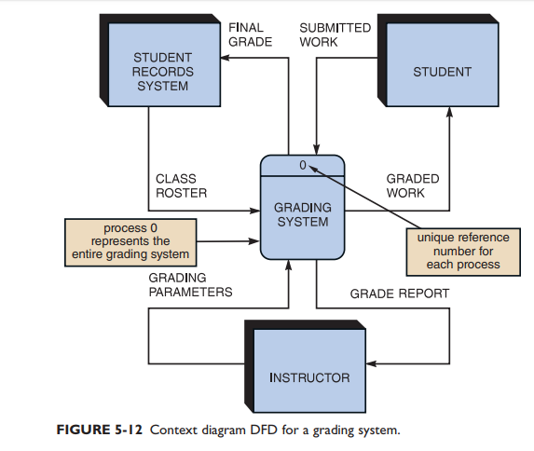
Context diagram for grading system

Slide 16
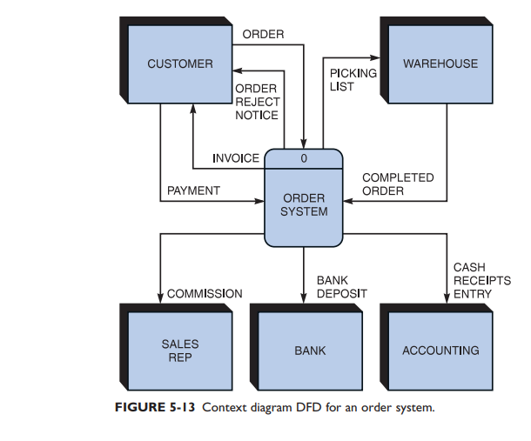
CONTEXT DIAGRAM FOR AN ORDER SYSTEM

Slide 17
CONTEXT DIAGRAM FOR AN ATM SYSTEM
The ATM must be able to provide the following services to
the customer:
A customer must be able to make a cash withdrawal from any
suitable account linked to the card. Approval must be obtained from
the bank before cash is dispensed.
2. A customer must be able to make a deposit to any account linked
to the card, consisting of cash. The customer will enter the amount of
the deposit into the ATM, then the verification will be conduct by the
machine for approval.
3. A customer must be able to make a balance inquiry of any
account linked to the card.
4. The ATM will provide the customer with a printed receipt for each
successful transaction, showing the date, time, machine location,
type of transaction.
The bank manager should receive a transaction report.

Slide 18
customer
Card data
Atm system
Account balance verification
0
bank
Withdraw request
Automatic summary reports
deposit request
inquiry request
Transaction reports
receipt
Bank manager
Response for transaction (complete or revise)

Slide 19
CONTEXT DIAGRAM FOR Online clinic management system
doctors
Patient report
Prescription
Patient data
clinic management system
0
Examination request
Patient
Reservation request
Medical lab
Available times
Patient car report
Examination results
Weakly report
Confirmation order
Confirmation (available medicine)
Maintenance order
supplier
Maintenance
office
management
Medicine order

Slide 20
Practice 1
Letters of complaint received from citizens are entered into a complaints master file by the City Clerk’s office. The date, department code, and a complaint description are stored for each letter. Weekly reports are produced from the complaints master file and given to the City Manager. Two weekly reports are produced: a department summary and a detail report of complaint.

Slide 21
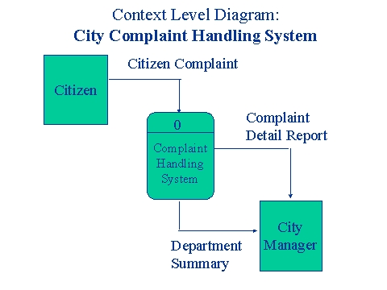
Practice 1 - Answer

Slide 22
Practice 2
The purpose of the campus bookstore is to supply textbooks to students for classes at a local university. The university’s academic departments submit initial data about courses, instructors, textbooks, and projected enrollments to the bookstore on a textbook master list. The bookstore generates a purchase order, which is sent to publishing companies supplying textbooks. Book orders arrive at the bookstore accompanied by a packing slip, which is checked and verified by the receiving department. Students fill out a book request that includes course information. When they pay for their books, the students are given a sales receipt.

Slide 23
Practice 3
The purpose of the plant science office is to document the study results from a wide variety of experiments performed on selected plants. A study is initiated by a researcher who submits a research proposal. After a panel review by a group of scientists, the researcher is required to submit a research plan and schedule. A FDA research permit request is sent to the Food and Drug Administration, which sends back a research permit. As the experiment progresses, the researcher submits experimental notes. At the conclusion of the project, the researcher’s results are reported on an experimental histogram.

Slide 24
Practice 4
Your client, Econ MiniBank, requests for a simple Automatic Teller Machine (ATM) system with the following requirements:
The system must be able to accept a customer's ATM card via a card reader and validate the account number using an account numbers file. The customer's transaction information, on the other hand, is entered via a key panel and also validated by the system. For valid account holders issuing valid transactions, the system determines the transaction type, which can be one of the following : display of account statement, hardcopy of account statement, cash transfers and requests for cheque book.

Slide 25
Practice 4 (con’t)
Transaction information would therefore include items like the customer's request (transaction type), cash transfer amount, and transferee's account number.
For account statement requests, the system retrieves the account information from a customer database and formats the information accordingly depending on whether a hardcopy or display is requested. For cash transfer requests, the cash amount and transferee's account number must be specified. Finally, for cheek book requests, the system uses a valid account number to determine the collection center and collection date from a collection schedule log and prints a collection slip for the customer.

Slide 26
Task 5
Perfect pizza wants to install a system to record orders for pizza and chicken wings. When regular customers call perfect pizza on the phone, their phone numbers goes automatically into the system.
The phone number invokes the name, address, and last order date comes automatically up on the screen, once the order is taken the total including the tax and delivery is calculated. Then the order is given to the cook. A receipt is printed. Special offers is printed so the customer can get a discount. Drivers who make deliveries give customer a copy of the receipt and offer (if any). Weekly totals are kept for comparison with last year’s performance.
Construct a context diagram for Perfect pizza.

Slide 27
Task 6
An airline reservation system is managing online booking ticket for customers.
Customers can do the following:-
1. Search for flights
2. Booking a ticket
3. Canceling a booking
4. Pay and confirm booking (confirmation is done after the
bank confirm the payment process)
5. Print the ticket after confirmation
The manager of the system uses it for generating reports for
monitoring the airline activities.
The flights details information is enter by a data entry.
Draw the following DFD
• Context diagram
Construct a context diagram for this scenario.

Slide 28
Provid a description for your project (abstract scenario)
Identify the problem of your project (Problems Statement)
Identify the objectives of your project
Identify the scope of your project
Identify the users of your project

